Slide 1
Business Process & Efficiency
Team Members: Jon Rapose, Charlie Haglund, Blair Kenimer, Mark Lewis, David Pearcill, Tim Sutton

Slide 2
Objective
Identify business processes that can be improved to eliminate rework and waste
Free up resources
Improve customer Experience
(Voice of Customer - VOC)
Improve efficiency with FPA sourcing Process
Notes:
This is the topic we were assigned and expanded on. Followed by the steps we took to arrive at this presentation
We followed the business process assessment by:
We surveyed service centers to provide feedback on our focus topic
We participated in the User Acceptance Team to see the testing environment before a new SAP function is released. We also had the opportunity to see a live example of how one of these ideas is pitched company wide.
In this presentation we detail our findings on the PO Acknowledgement process and how we arrived to our conclusions.

Slide 3
The Problem
Service Centers process multiple requests from customers for non standard items daily. These non standard items can be difficult to source, resulting in excessive quote response time from Applied associates.
Data Findings
FPA’s were 47% of our annual revenue, and 21.4% of total line items processed in FY 15
FPA’s average profit margin was 22% in FY 15
Average research time for Non Core, Non Standard FPAs: 10.5 minutes (based on study findings)
MSP was the most frequent material group entered (119,730 FY 15)
FPA’s have a huge impact on our business!
Notes:
Emphasize MSP is 1/6 of all FPAs
Non-standard: (we should define during the presentation)
Field Products Add materials are a pivotal part of the Applied business model, accounting for nearly 47% of our annual revenue, and 21.4% of the total line items processed in 2015. While these items tend to garner a higher margin (need data here), they are typically more difficult to source, especially from non-core suppliers.
In 2015, we ordered 119,730 non-Core MSP line items. Using the average sourcing time of 10 ½ minutes shown from our survey, this translates to 44,000 man hours spent sourcing non-core MSP items in 2015.
Conservatively estimating that process improvement recommendations and refinements can reduce sourcing time by up to 5 minutes, this represents an annualized savings of approximately 10,000 man hours for AIT.

Slide 4
Existing FPA Entry Process (Map/Flow)
Should the customer wait this long?
Notes:
Enter FPA into SAP should not happen until ready to start quote or purchasing process

Slide 5
FPA Time Study Activity
Our team polled service centers from across the US. Data was collected from:
18 service centers selected by Operations Managers
39 associates logged the time it took to source non-standard items
Data collection time of one week
166 entries were returned for analysis
Associates were willing to participate in survey

Slide 6
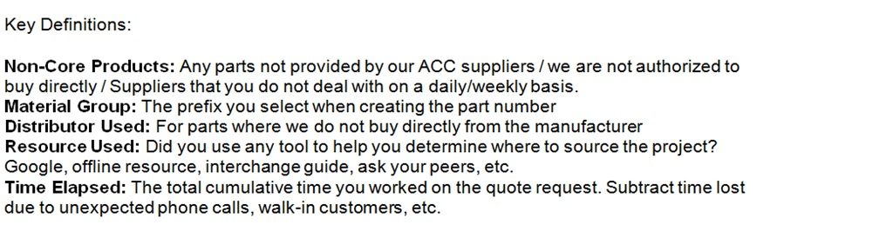
Survey Template Used
What we asked for
Material Group
SAP Material Number
Part Number
Manufacturer
Distributor use
Resource used to find item
Active time sourcing part
Notes:
Tim can touch on how data was collected – should we mention possible factors skewing data?

Slide 7
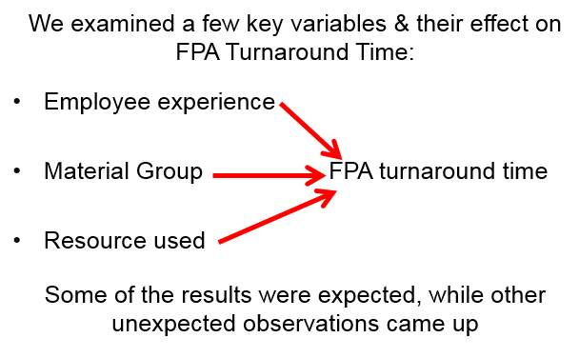
Data: Variables
What variable will have the biggest impact
Notes:
Tim can touch on how data was collected – should we mention possible factors skewing data?

Slide 8
Data Analysis: Experience Vs. FPA Turnaround
Graph of Raw Data:
Each pair of bars represents an associate that took our survey
The data is sorted in descending order by Turnaround time
Associates’ averages ranged from 2-30 minutes
Notes:
NOTES NEEDED

Slide 9
Data Analysis: Experience Vs. FPA Turnaround
Graph of Raw Data:
There is no obvious correlation when graphing all associates

Slide 10
Data Analysis: Material Vs. FPA Turnaround
Material Group Data:
Material Group | FPA Avg Time (Minutes) | Count of Survey Line Items
MSP | 9.7 | 35
MELP | 8.8 | 8
MISC | 18.4 | 7
MTLS | 6.8 | 6
SYSP | 2.0 | 6
NORD | 10.0 | 4
ZERO | 12.5 | 4
MELM | 16.8 | 4
MSP accounted for over 20% of our Survey FPA volume
Miscellaneous items made up 40% of survey FPA volume
There were more than 50 other groups with less than 4 line items each
Other than MISC, FPA lines spread thin over many Mat’l Groups!
Notes:
So we didn’t see a correlation between associate experience
we didn’t see a correlation between
MSP accounts for more than two times the line items of the line item count and revenue Dollars than the next Material group category.

Slide 11
Data Analysis: Resource Used Vs. FPA Turnaround
Resource Data Summary:
Resource Used | FPA Avg Time Elapsed (Minutes) | Average of Experience (Years) | Count of Survey Line Items
Google | 12.55 | 10.65 | 56
VENDOR | 8.94 | 8.26 | 53
Tribal Knowledge | 6.08 | 6.02 | 24
PAST SALES | 16.43 | 17.36 | 7
System | 12.00 | 8.64 | 7
}
>80% of Lines
Google, Vendor, and Tribal knowledge need further analysis!
Notes:
We expected to see the times drop from Google to Vendor (3.61 minutes)
and from Vendor to Tribal Knowledge (additional 2.86 minutes)
We did not expect the average experience to drop along this progression
To further investigate this, we examined these three resources in more detail
Define tribal knowledge
What are the problems with finding items through Google?

Slide 12
Data Analysis: Common Resources
Google
33.7% of lines
12.55 minutes ea.
Vendor
31.9% of lines
8.94 minutes ea.
Tribal Knowledge
14.5% of lines
6.08 minutes ea.
FY 2015:
223,035 Lines /
46,651 Prod. Hrs
FY 2015:
211,122 Lines /
31,457 Prod. Hrs
FY 2015:
95,964 Lines /
9,724 Prod. Hrs
We are using our MOST efficient resource the least

Slide 13
Data Analysis: Tribal Knowledge
Tribal knowledge is mainly used by new associates
Projected over FY15 Data:
79,969 lines
As associates retire, this value leaves with them
We need a tool to grab this value!
Notes:
(Reword Bangbox)

Slide 14
Data Analysis: Efficiency Gained
Waste Calculation:
661,827 X 10.5 = 6,949,183min = 115,819 Working Hours
For every minute we can reduce on sourcing Non Core FPA items:
11,030 Productivity Hours are Saved
This will allow for more profitable activity such as Quote Follow-up & Collections activity!
Even a small improvement has a significant impact!

Slide 15
Our Recommendations
The Knowledge Bank
The Miscellaneous P.I.G (Product Identification Guide)
Notes:
We feel this slide will garner the audience’s curiosity

Slide 16
The Big Idea
Knowledge Bank
Find Information By:
Searching by Manufacturer
Searching by Product Keywords
Browsing by Region
Examples of Information:
Order Minimums
Shipping Terms
Best Method of Contact
Alternative Sources
Link to Supplier’s Website
Everything We Need in One Location

Slide 17
Knowledge Bank Benefits
Faster response times
Deeper customer penetration
Service center collaboration
Leverage our spend with suppliers
Accelerated training
Invest in the Bank, and Reap the Benefits

Slide 18
Challenges
Considerations
Governance
Field Adoption
Data Validation
Project Funding
Your investment will be worth it!

Slide 19
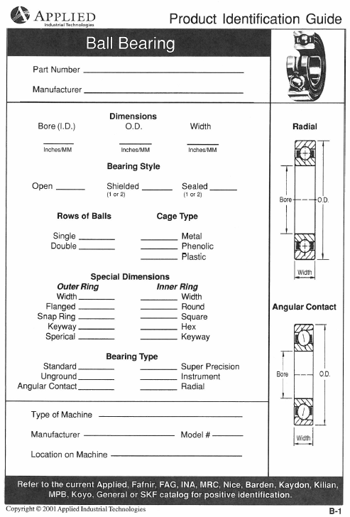
The Miscellaneous P.I.G
Online PDF
Benefits:
A guide to identify unknown parts based on criteria
A tool for associates to ask the right questions
Eliminates communication waste with vendors and customers
Notes:
While in Cleveland, make an example for the die spring above, and hand out
Need help with making the document, and the order of presentation
Product you would like to see a PIG for? E-mail to nonstandardproduct@applied.com

Slide 20
Benefits Recap
Knowledge bank will improve efficiency with FPA sourcing process
Improved response times
Additional Benefits:
Captures intellectual capital
Builds Customer Loyalty
Finds optimal supplier the first time
Consolidation of vendors
Improved training

Slide 21
Thank you for your time!
Questions?

